Slide 1

Contingent Faculty and the Future of Higher Education: What Role Can University Life Play?
Marisa Allison
Graduate Assistant
Women and Gender Studies
#adjunct
Notes:
Top # of Adjuncts are in Education, Humanities, and the social sciences

Slide 2
Learning objectives
Identify the shift toward the increasing use of contingent/adjunct faculty on college campuses and the impact that this has on our student populations
Recognize the role that collaborations among ULIFE offices and contingent faculty can play in meeting the goals we have for academic-student development programming
Identify the ways in which contingent faculty can be engaged in ULIFE collaborations and programming
Recognize that though there are challenges, the experiences of contingent faculty and ULIFE staff can be enriched through the types of professional development opportunities available through ULIFE
#adjunct

Slide 3



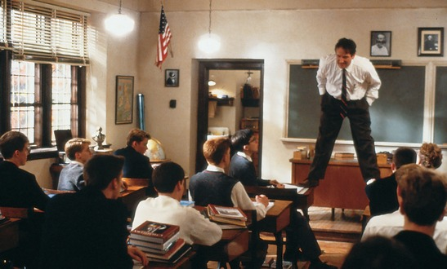
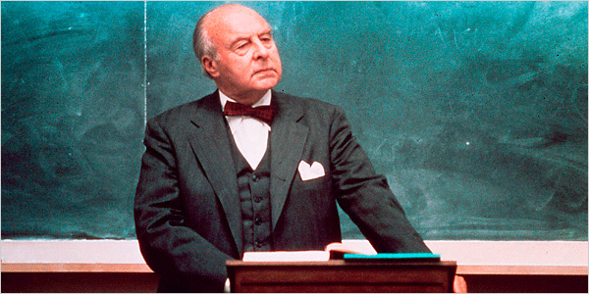
What do you picture when you think of a professor?
#adjunct
Notes:
What do you picture when you think of a professor?

Slide 4
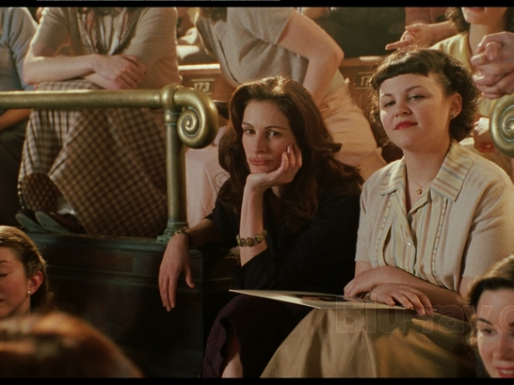
Mona Lisa Smile, 2003
#adjunct
Notes:
In 1953, Katherine Ann Watson (Julia Roberts), a 30-year-old graduate student in the department of Art History at Oakland State, takes a position teaching "Art History" at Wellesley College.
The fact is that professor Katherine Ann Watson was given a few things:
A place to live near campus.
An Office
Supplies

Slide 5
Contingent Faculty?
Contingency is an umbrella term describing the precarious employment of the majority of faculty in higher education.
Adjuncts
Lecturers
Non-Tenure Track Faculty
Term Faculty
Part-Time
Post-Docs
Teaching Assistants
#adjunct

Slide 6
Data derived from National Center for Education Statistics Integrated Postsecondary Education Data System

Slide 7
Contingent faculty comprise over 2/3 of the faculty workforce nationally.
There’s no one type of contingent faculty
#adjunct
Notes:
There’s no one type of contingent faculty:
Some have full time jobs, others are freeway flyers
Some do it because they are retired, Others have been on the job market for a tenure track position for years.

Slide 8
Mason Stats in 2009
Tenure Track and
Tenured Faculty
39%
Contingent Faculty
61%
The future of higher education is tied up with the future of contingency.
What will Mason look like in 10 years?
#adjunct

Slide 9
Challenges to contingent faculty work life
Unequal Compensation
Lack of Job Security
No Academic Freedom
Non-inclusion in Faculty Governance
Lack of Professional Development
Lack of Advancement Opportunities
Little to No Benefits for part timers
#adjunct
Notes:
Unequal Compensation: The median pay per 3-credit course was $2,700 in fall 2010: Coalition of the Academic Workforce versus an average of $84,000 earned by universities per class.
Go to next Slide
Lack of Job Security: No knowledge of whether you will be hired back.
No Academic Freedom: Skip two slides
Non-inclusion in Faculty Governance
Lack of Professional Development
Lack of Advancement Opportunities
Little to No Benefits

Slide 10
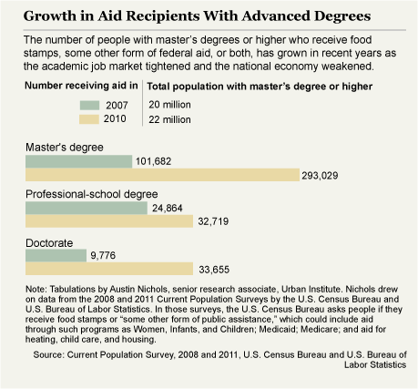
#adjunct
Notes:
Go Back A Slide

Slide 11
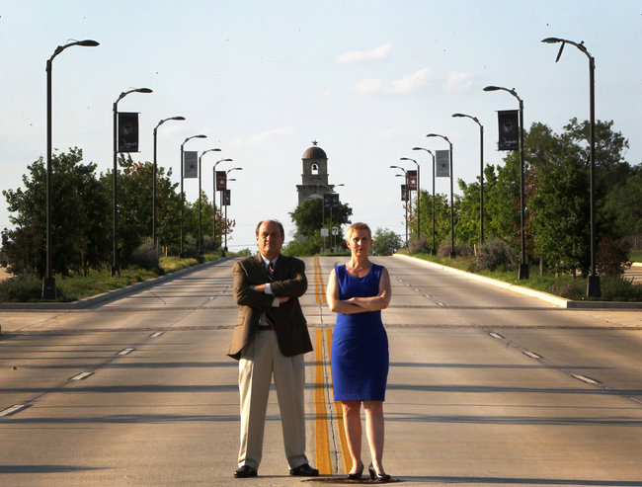
Sissy Bradford, Adjunct
#adjunct
Notes:
Last fall, Sissy Bradford, an adjunct instructor who taught criminology at Texas A&M University-San Antonio, questioned why crosses were being placed near the public university’s entrance. Last month, she was informed that the university would not offer her any courses to teach in the fall semester.
Ms. Bradford, who has received teaching awards from the university system and higher-than-average student evaluations, had already informed the university that she intended to leave at the end of 2012.
Though she had previously been told that she would be teaching four courses in the fall, officials said this was done on a tentative basis. Twenty adjunct faculty members were not renewed for next semester.

Slide 12
Challenges for Students
Limited instructional resources.
Limited course prep time.
Lack of input into course and syllabus designs.
Lack of office space to meet with students.
Lack of training of diverse student population needs.
Limited stature to speak from when writing recommendation letters often needed by students for grad school, etc.
#adjunct
Notes:
Limited instructional resources. Skip to next slide
Limited course prep time: 67% had three weeks or less to prep their course
Lack of input into course and syllabus designs.
Lack of office space to meet with students.
Lack of training of diverse student population needs:
Limited stature to speak from when writing recommendation letters often needed by students for grad school, etc.
Center for the Future of Higher Education

Slide 13
Limited Instructional Resources
47% received copying services less than two weeks before classes started
45% gained library privileges less than two weeks before classes started.
38% received access to office space less than two weeks before classes started
34% did not receive sample syllabi until less than two weeks before classes started
#adjunct

Slide 14
Student Outcomes
Diminished Graduation and Retention Rates
Negative Effects to Early Exposure to Part-Time Faculty
Reduced Faculty-Student Interaction
#adjunct
Notes:
Ehronberg and Zhang (2004) and Jaeger and Eagan (2009) found that graduation rates declined as NTT faculty populations rose.
Lower second-semester retention rates, lower GPAs, fewer attempted credit hours
Contact time and interaction with students are shown to foster student success.

Slide 15
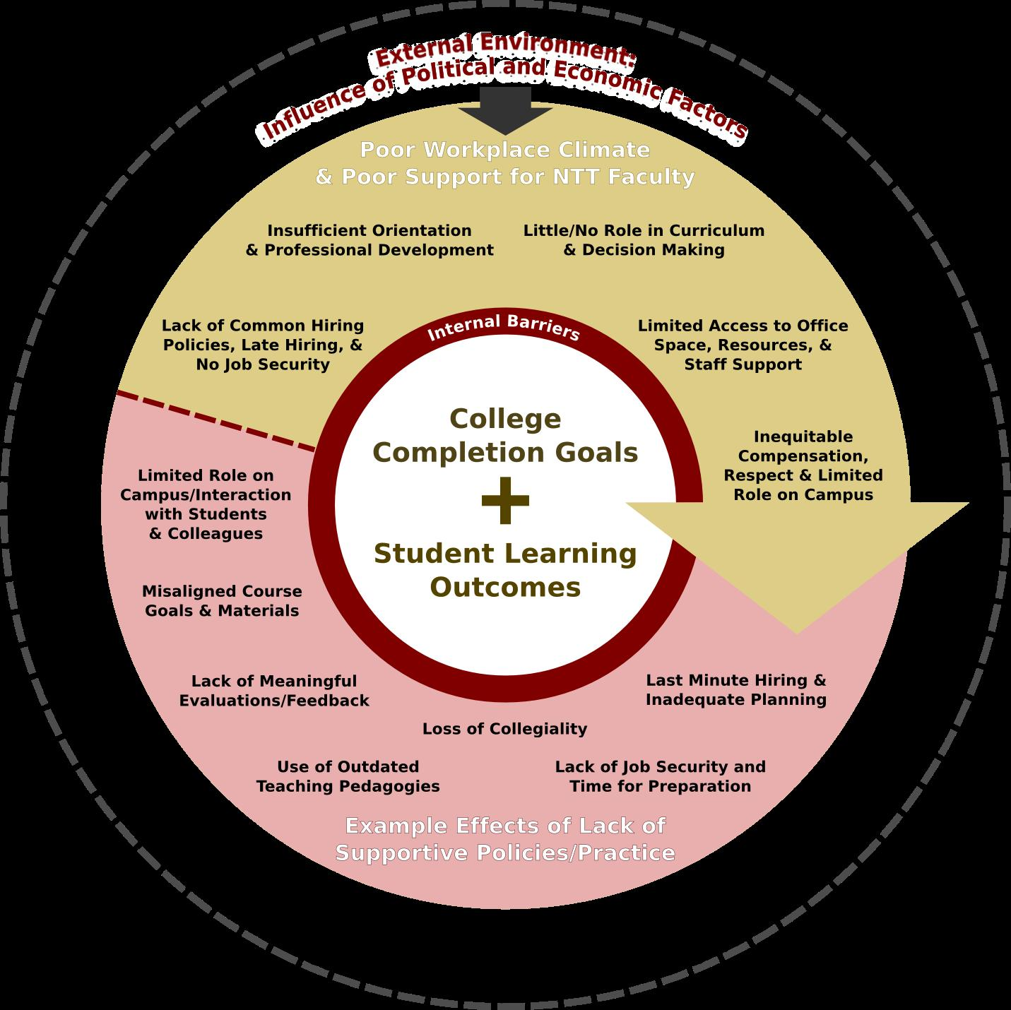
How can ULife Departments Foster Collaboration with Contingent Faculty?
Source: The Changing Faculty and Student Success, pullias.usc.edu

Slide 16
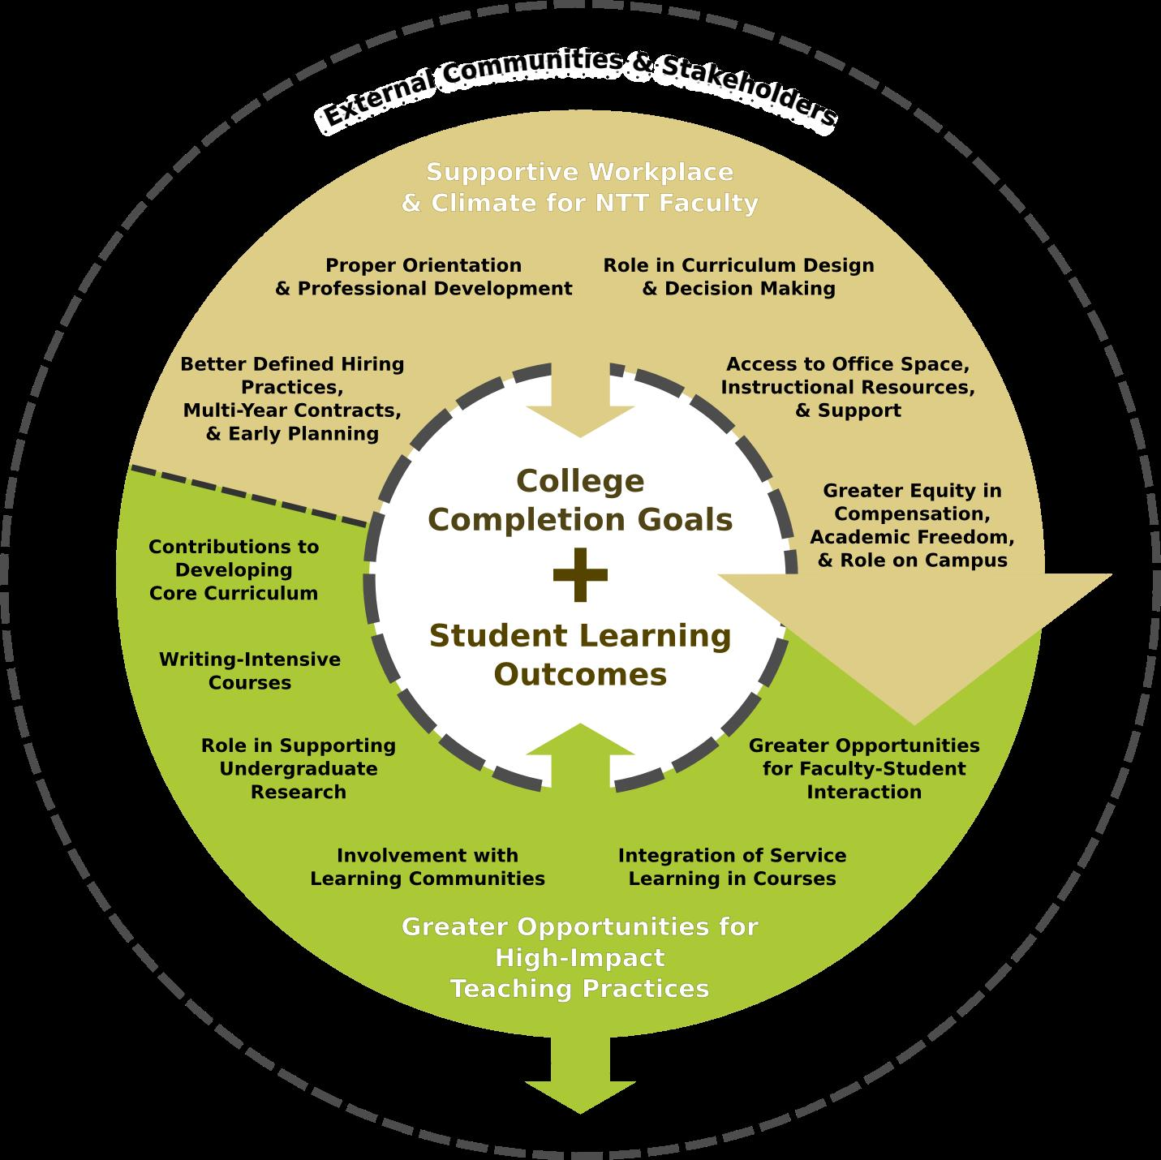
How can ULife Departments Foster Collaboration with Contingent Faculty?
Source: The Changing Faculty and Student Success, pullias.usc.edu

Slide 17
‘Junct:
The trashing of higher ed
#adjunct

Slide 18
“Our Working Conditions are Student Learning Conditions”
#adjunct

